Slide 1








PARKING
SERVICE
RENTALS
By : MAVERICK

Slide 2







Introduction
Parking cars on roads leads to heavy traffic and congestion. To solve this, we’ve introduced a car parking rental system using private properties. People can rent out their unused parking spaces, making parking easier and roads less crowded

Slide 3
Goals
Utilize unused private parking spaces efficiently.
Provide a convenient platform for users to find and book parking spots easily.
Enable property owners to earn income by renting their parking spaces.
Promote smart urban planning through better space management

Slide 4
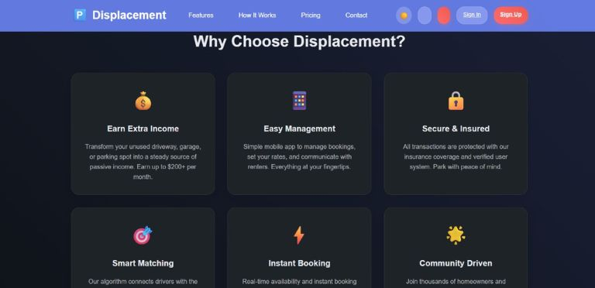
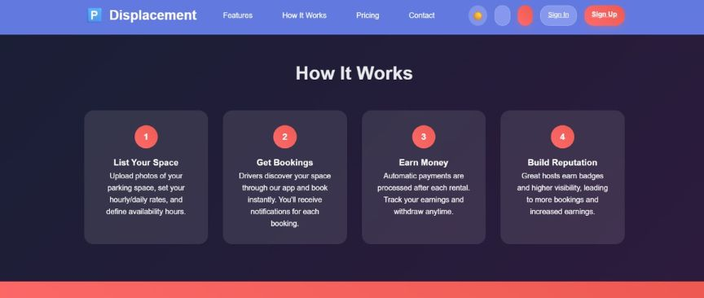
Project Overview

Slide 5

Objectives
Minimize illegal and roadside parking through effective alternative options.
Enable real-time tracking of parking space availability and bookings.
Provide location-based search and navigation to available parking spots.

Slide 6
Services
Vehicle Wash
Vehicle Repair
Fuel Delivery
EV Charging
Vehicle Insurance
Valet Service

Slide 7
Filters
EV charging port availiablity
CCTV surveillance
Security guard
Covered parking

Slide 8
Conclusion
In conclusion, the car parking rental system helps reduce traffic by utilizing unused private parking spaces. It offers a convenient and efficient solution for both drivers and space owners. This approach supports smarter urban mobility and better space management.

Slide 9
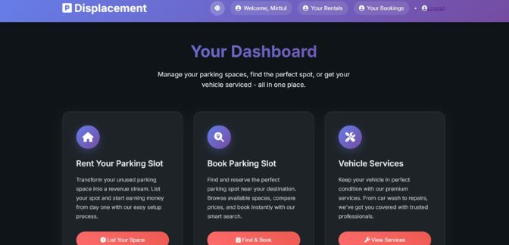
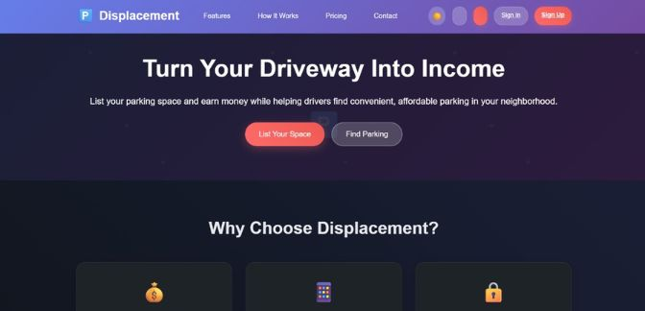
Project Overview

Slide 10
Let’s Work Together!
Contact :
hello@reallygreatsite.com
0123 4567 8901

